Slide 1
AngularJS
AngularJS
Lecture 4
By James(Jin) Wang
08/01/2019

Slide 2
Outline
Routing Overview
Referencing the ngRoute Module
Configuring Routes
Using the ng-view Directive

Slide 3
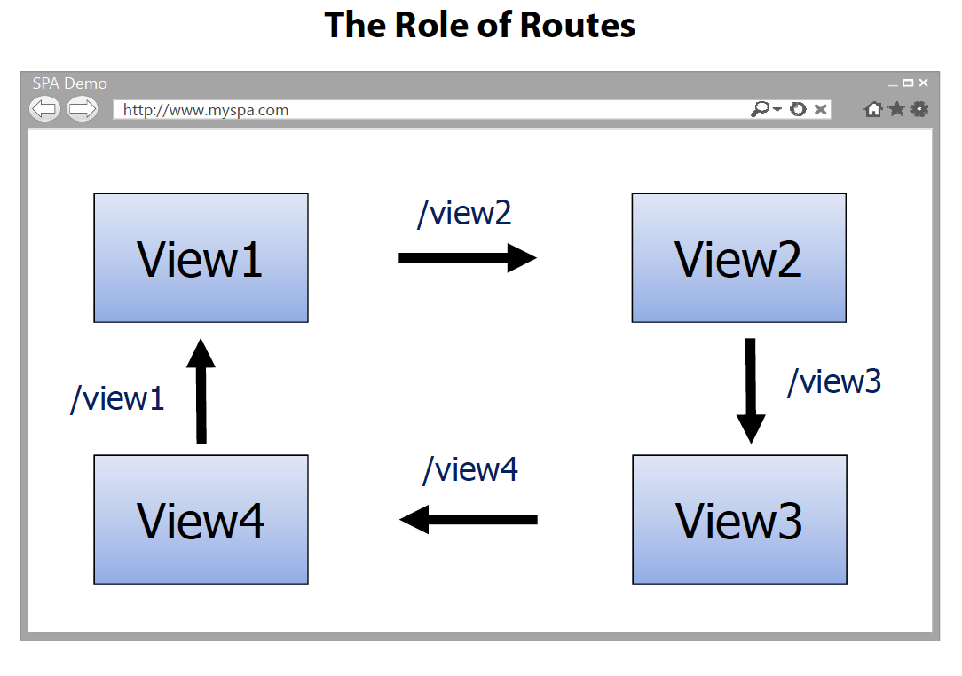
Routing
  Routing Overview:

Slide 4
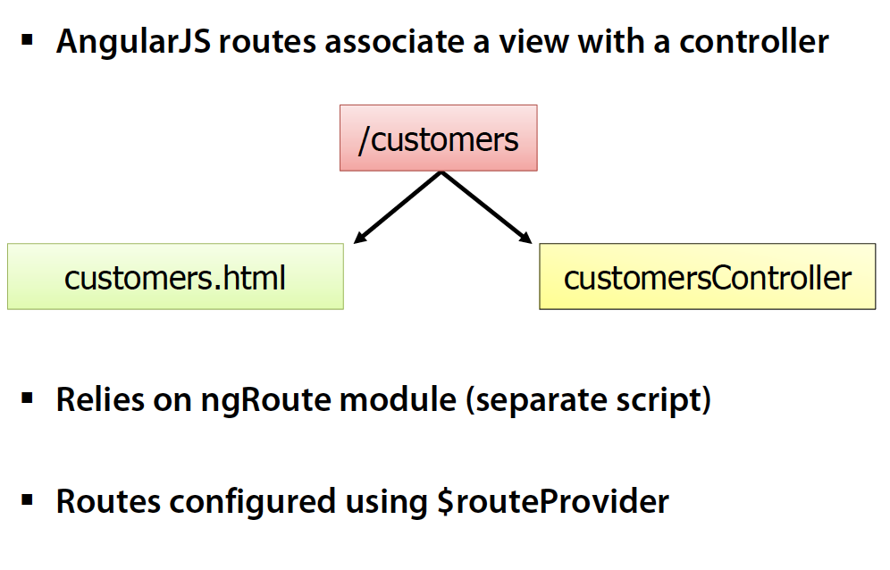
Routing
  Routing Overview:

Slide 5
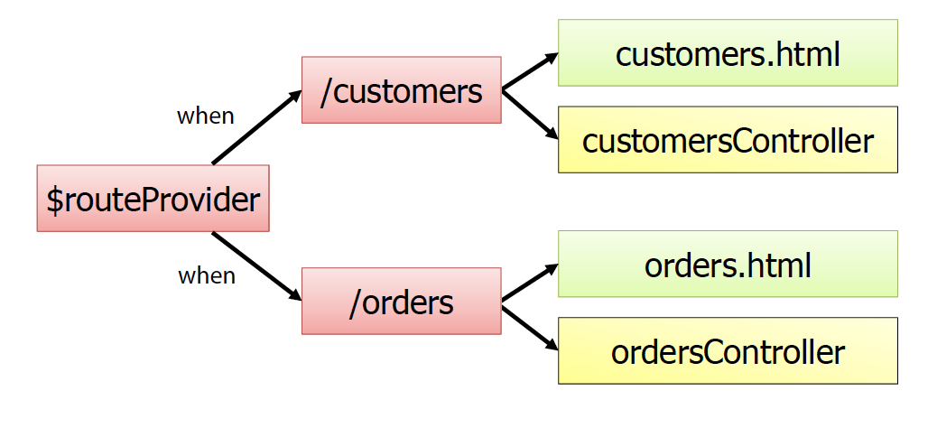
Routing
  Routing and Modules:
  Routes configured by calling angular.module.config()
  $routeProvider injected dynamically

Slide 6
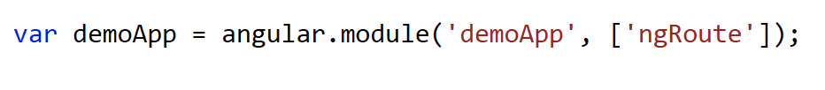
Routing
  The ngRoute Module:
  AngularJS routing functionality is located in the ngRoute module
  Add a <script> that loads angular-route.js
  Reference ngRoute in your module:

Slide 7
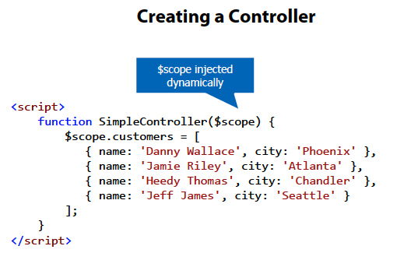
Controller, Scope and Modules

Slide 8
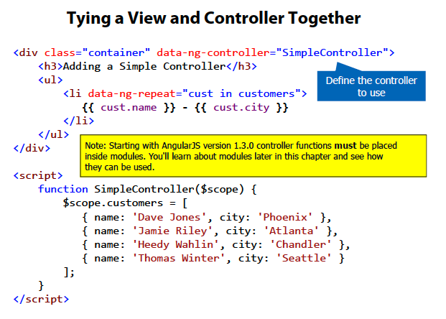
Controller, Scope and Modules
  The ng-controller Directive:

Slide 9
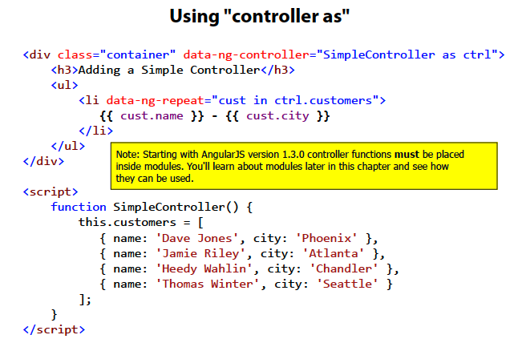
Controller, Scope and Modules

Slide 10
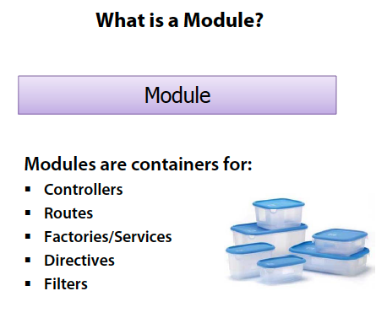
Controller, Scope and Modules
  The Role of Modules:

Slide 11
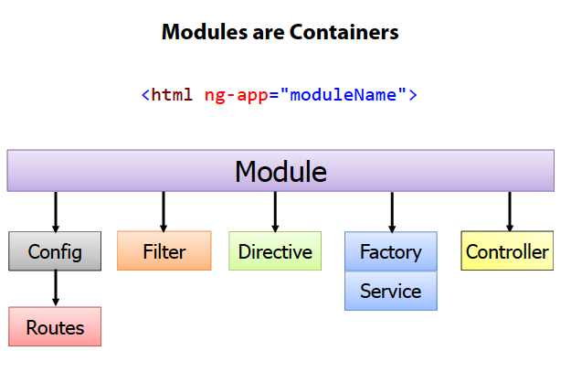
Controller, Scope and Modules

Slide 12
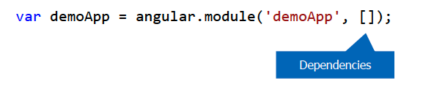
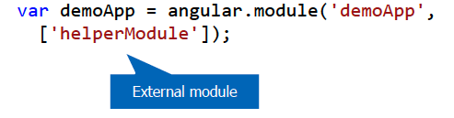
Controller, Scope and Modules
  Defining a Module:
  Create a module using angular.module():
  Injecting Dependencies into a Module:
  Modules may rely on functionality from other modules
  Helper modules can be “injected” into a module:

Slide 13
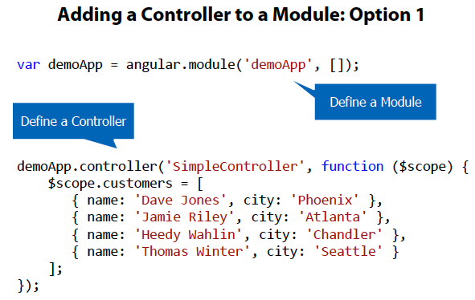
Controller, Scope and Modules
  Adding a Controller to a Module:

Slide 14
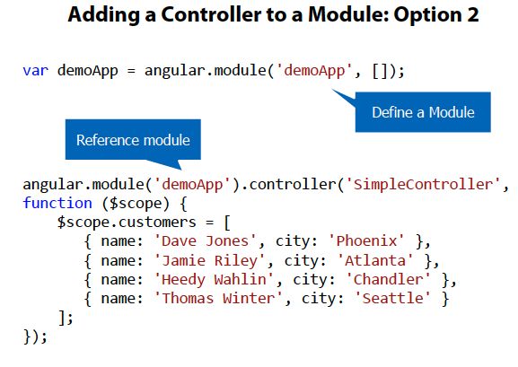
Controller, Scope and Modules

Slide 15
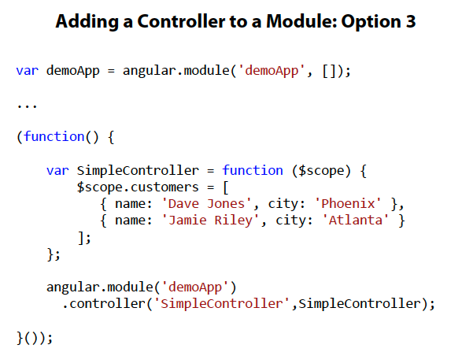
Controller, Scope and Modules

Slide 16
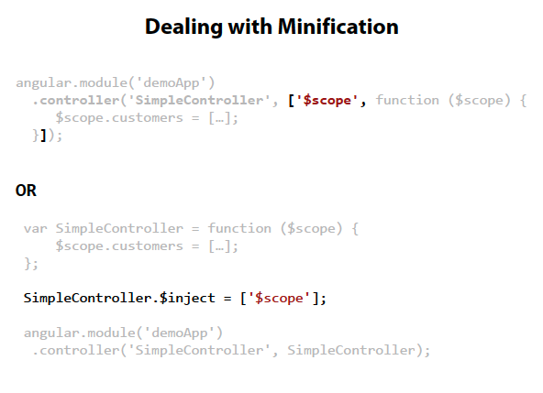
Controller, Scope and Modules

Slide 17
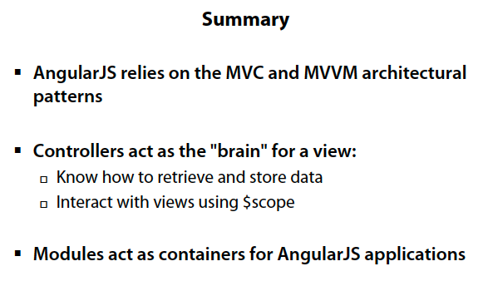
Controller, Scope and Modules

